Slide 1
Past simple regular and irregular verbs
Universidad de Cundinamarca

Slide 2
Past Simple
Watch the video and answer the following questions.
Did Alfie pass his driving test?
What happened when he was presenting his driving test?
How many times has Alfie failed his driving test?
What was the reason that Alfie did not pass his driving test?
https://learnenglishteens.britishcouncil.org/grammar/beginner-grammar/past-simple-regular-verbs

Slide 3
Past simple
The past simple is the most common way of talking about past events or states which have finished.
Past time references: Yesterday, ago, last….year, last month.
Ex: Mary finished her homework yesterday.
Ex: Alfie did not pass his driving test two days ago.
Ex: They bought their new car last month.

Slide 4
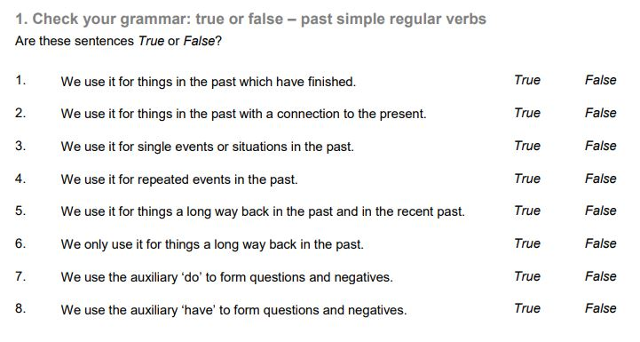

Slide 5
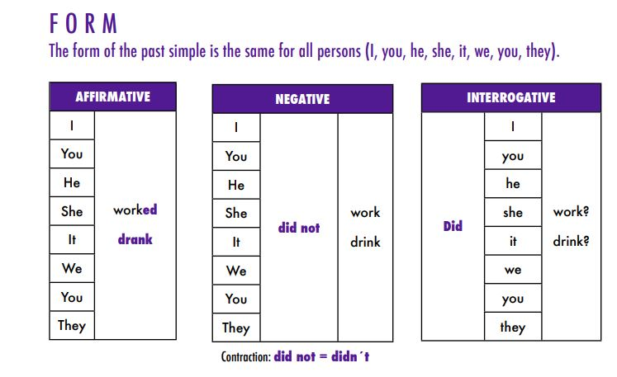

Slide 6
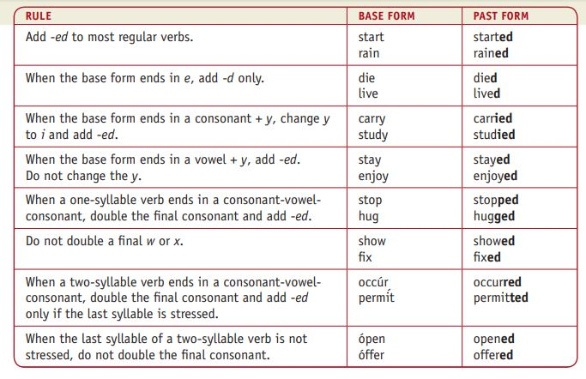

Slide 7
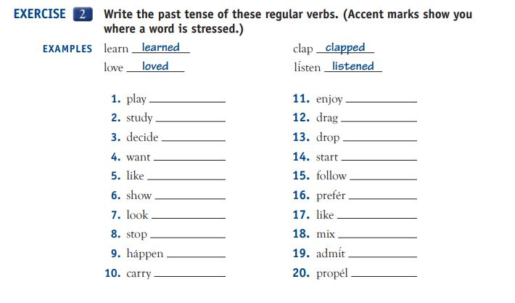

Slide 8
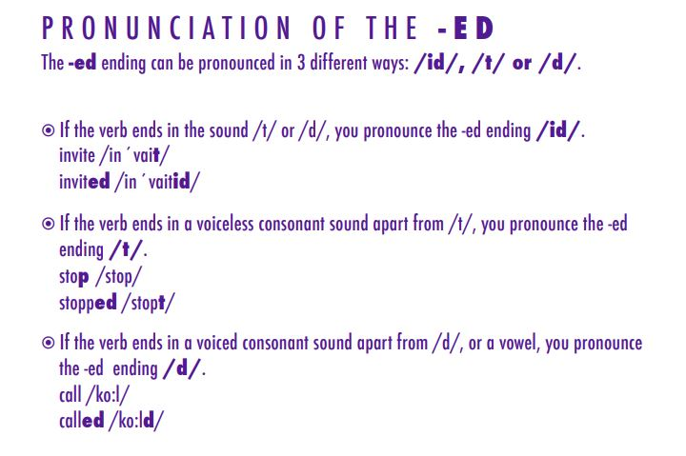

Slide 9
Irregular verbs
Exercises
https://en.islcollective.com/video-lessons/simple-past-irregular-verbs-carl-ellie
List of the irregular verbs.
http://englishtsuid1101.pbworks.com/f/irregular+verbs+in+English.pdf

Slide 10
